Slide 1

Heart Failure Prediction
6th Sem Minor Project
1905189 – Pratyush Aanand
1905599 – Aryan Sarraf
1905600 – Ashutosh Mishra
1905634 – Sambhav Choudhary

Slide 2
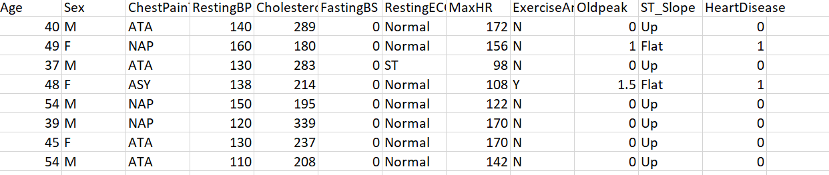
DESCRIPTION AND DATA SET
Using Machine Learning and Deep Learning predict the likelihood of person having a heart attack

Slide 3
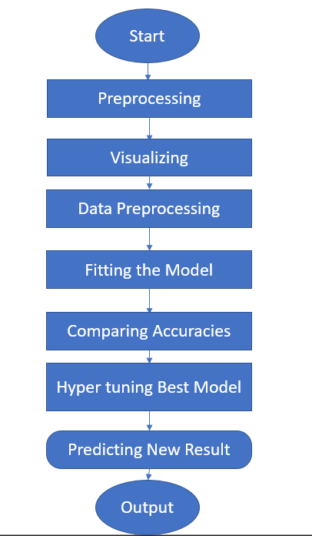
Program Flow Diagram
Dataset is a simple one, and output are in range {0,1} which means the best suitable are the classification models. So our approach should be
Data Pre-processing
Visualising the Data
Splitting Data into Training and Test set
Feature Scaling
Training on Model
Calculating accuracies
K-Fold Cross Validation
Hyper tuning Best Performing Model
Predicting a single result
Conclusion

Slide 4
PREPROCESSING
First Step of pre-processing is to importing necessary libraries “NumPy”, ”pandas”, ”matplotlib”, ”sklearn”, “tensorflow”
Next step would be import the data set from csv file using a dataframe
Now the task falls to check for redundancy and empty cell in dataframe

Slide 5
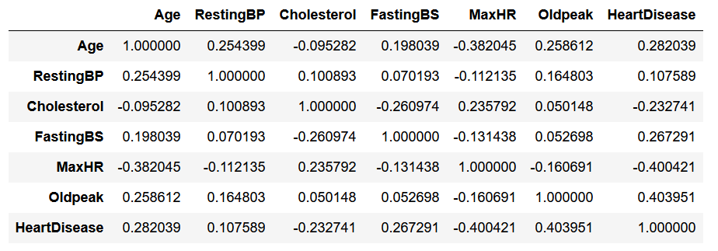
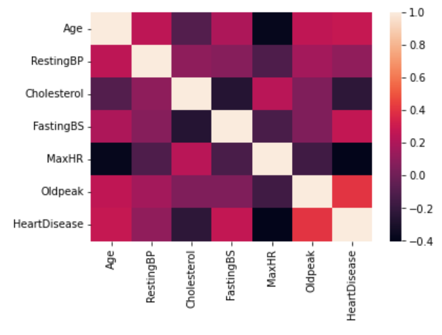
Correlation Between attributes and Heatmap

Slide 6
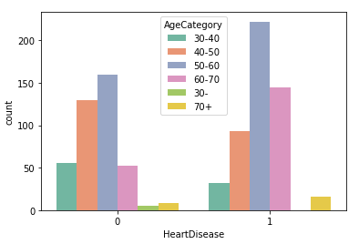
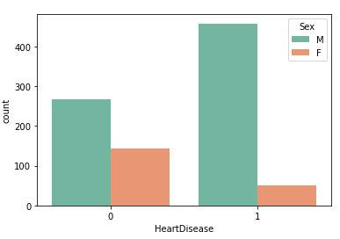
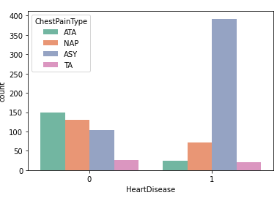
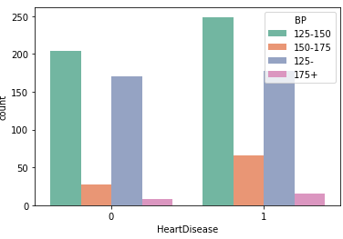
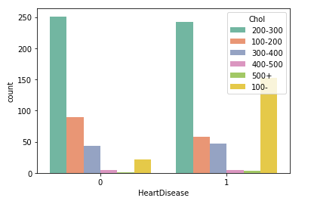
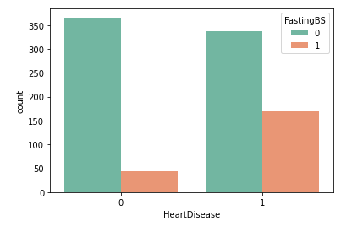
Data Visualisation And Analysis

Slide 7
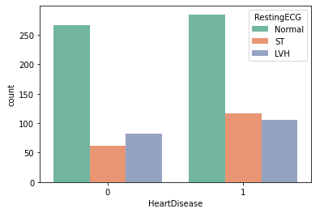
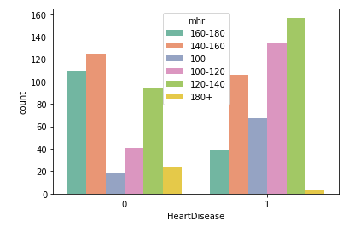
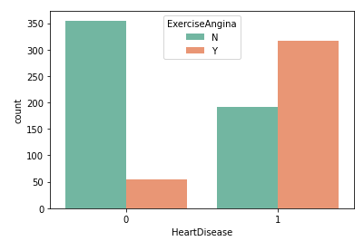
Conclusion From the Graph
People likely to get Heart attack
Age>50
Sex = Male
Regularly having Asymptomatic chest pain
Fasting BS >120
Exercise Anigna =Y

Slide 8

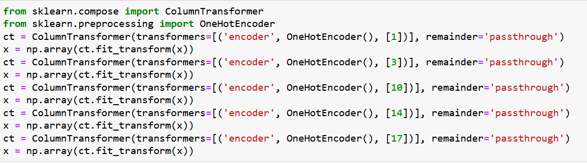
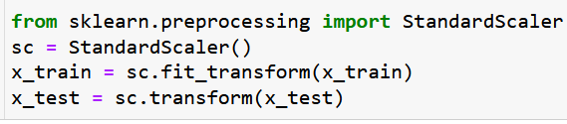
Data Pre-processing
11 attribute, 10 are independent variable. Heart Disease is Target Variable, X={Independent Variable}, Y={dependent Variable}
Sex, ChestPaintype, Resting ECG, Exercise Angina, ST_Slope are categorical data – OneHotEncoding
Splitting Data into 3:1 For Training 75% and for Test 25%
Feature Scaling

Slide 9
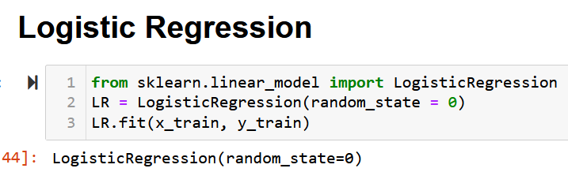
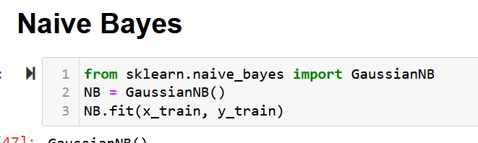
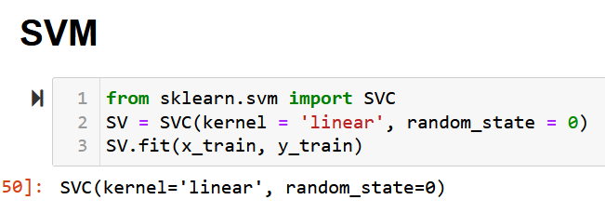
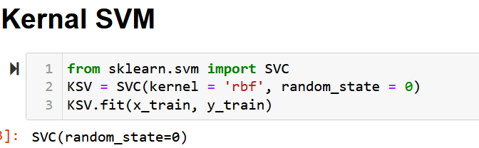
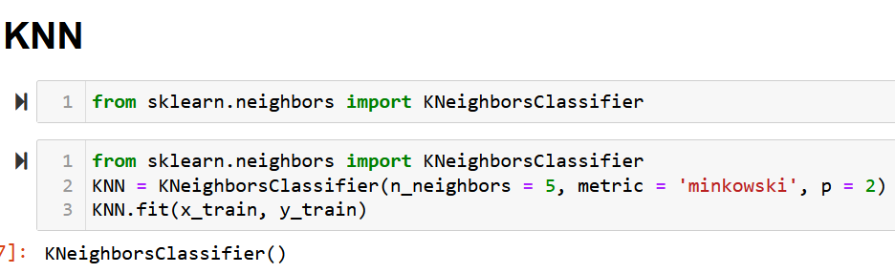
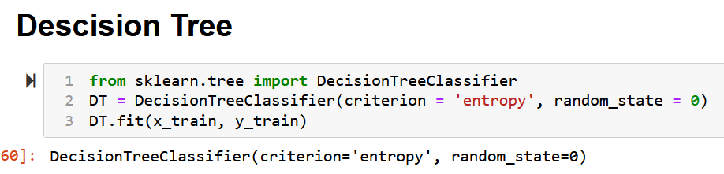
Fitting the MODELS

Slide 10
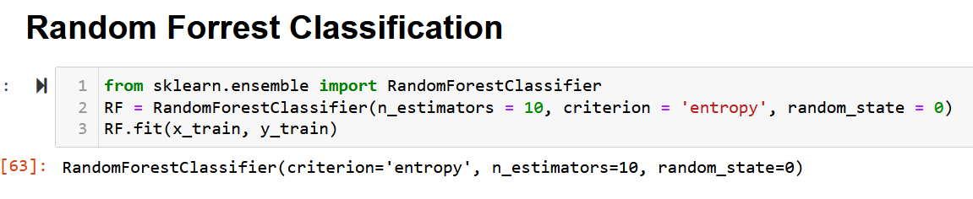
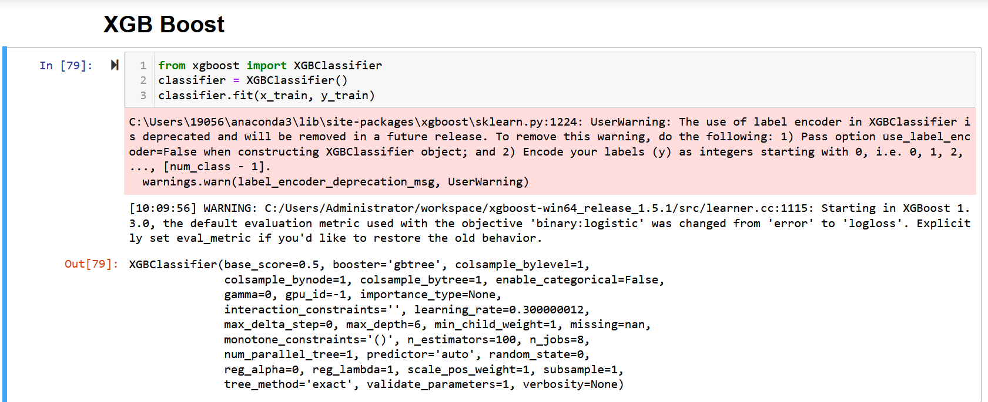

Slide 11
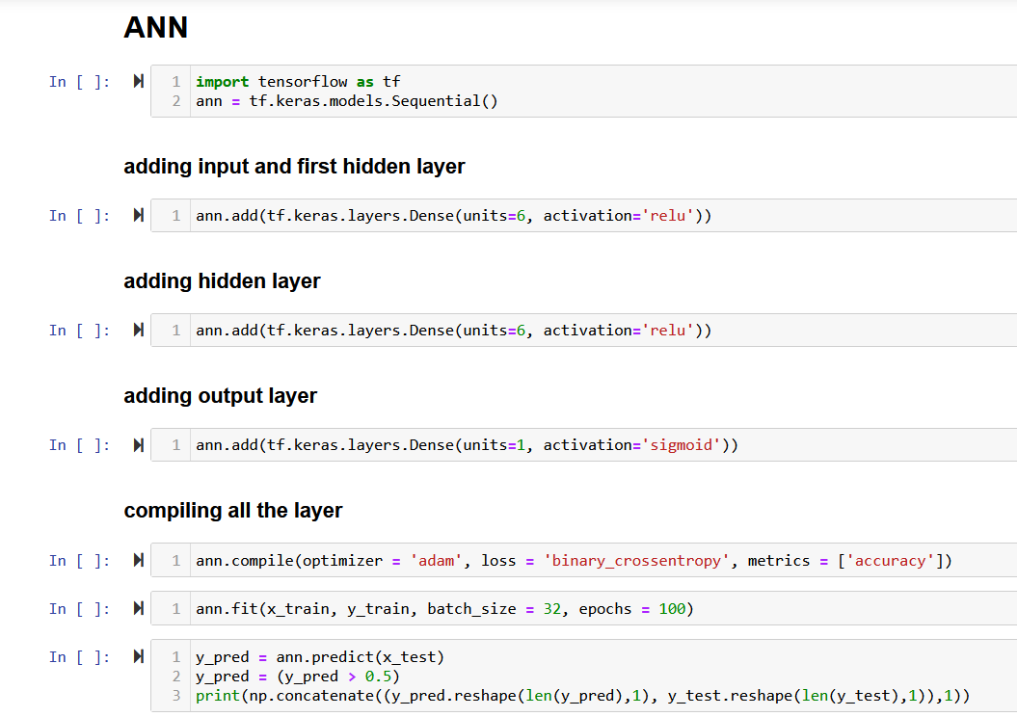

Slide 12
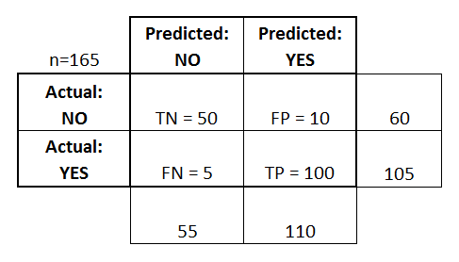

Confusion Matrix
After the model is tested on test set we have four condition
Actual value of y=0 and predicted value of y=0 (ture negative)
Actual value of y=0 and predicted value of y=1 (false positive)
Actual value of y=1 and predicted value of y=0 (false negative)
Actual value of y=1 and predicted valued of y=1 (true positive)
False negative is much more dangerous of an error in comparison to false positive as, a person not having a heart attack when predicted we would, doesn’t bother as much as a person having a heart attack but predicted not to.
Based on these four outcomes we create a confusion matrix in which y actual is assigned row value and y pred columns value and we represent using
A₀₀ as true negative, A₀₁ as false positive, A₁₀ is false negative, A₁₁ is true positive
Using this we can calculate the accuracy of our model as
Correct prediction = TN+TP = 50+100 = 150
Total Value = n = TN+FP+FN+TP = 165

Slide 13
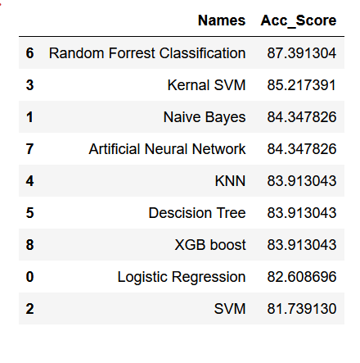
ACCURACIES USING CONFUSION MATRIX

Slide 14
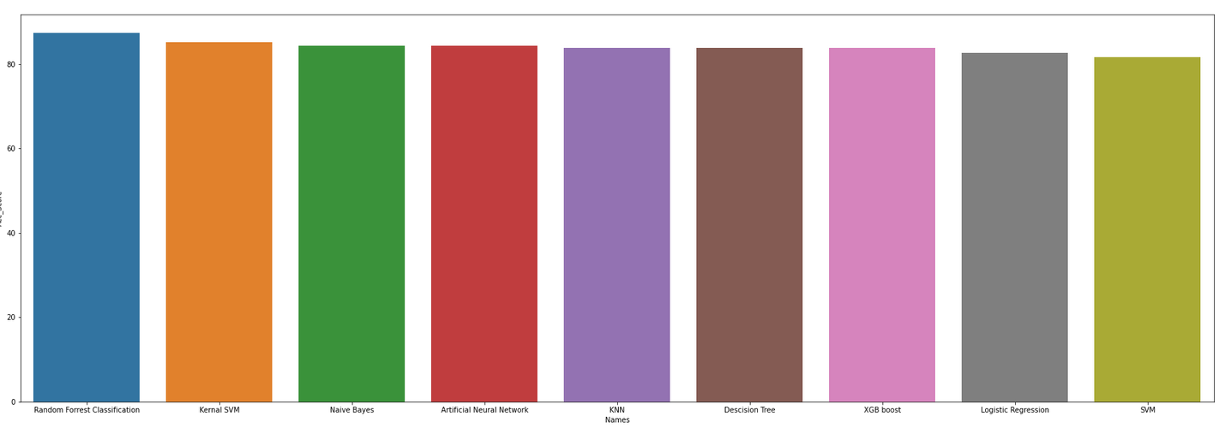

Slide 15
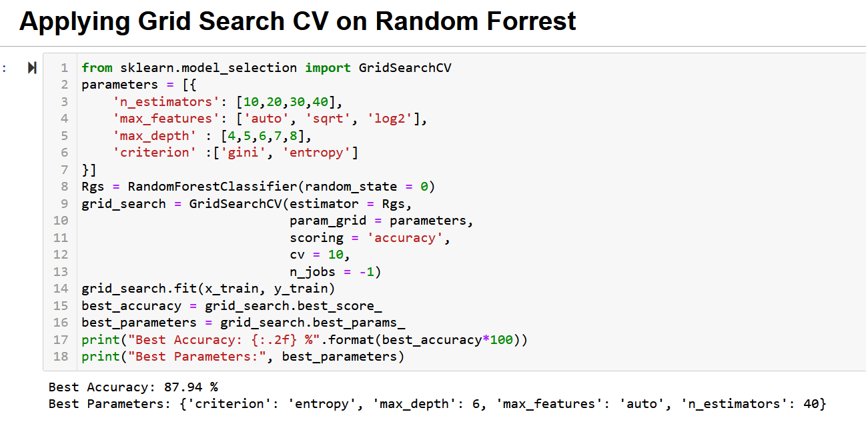

Slide 16
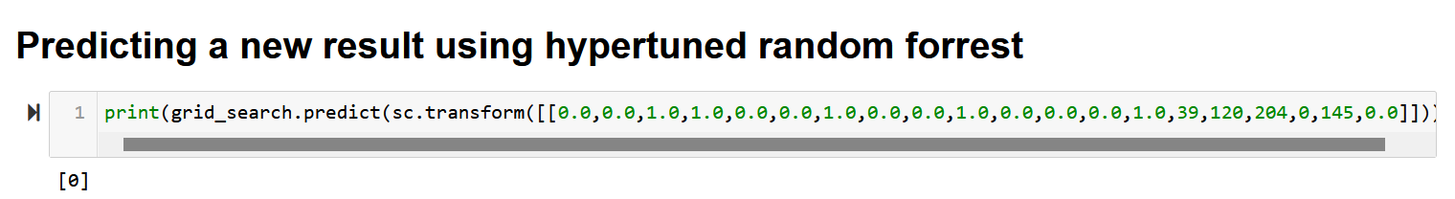
Predicting a New RESULT

Slide 17
Reference
https://www.kaggle.com/datasets/iamaniket/suv-data
https://seaborn.pydata.org/
https://scikit-learn.org/stable/
https://www.geeksforgeeks.org/python-programming-language/
https://stackoverflow.com/

Slide 18
Thank you

